Slide 1
The Modern Day Village Approach
Implementing Check & Connect from a Kiwi - Pacific Island perspective

Slide 2
Exploring the past A story of our journey
Photo from; nzhistory.net.nz

Slide 3
Weaving Check & Connect and the Village approach together.

Slide 4
What is the Modern Day Village approach? Why use a village approach with Check & Connect?
Traditional
VS
Modern

Slide 5
Connections/ Relationships
In the context of Check & Connect:
Students desire to belong and feel accepted to something.
Connection between family and school increases likelihood of school completion.

Slide 6
Talanoa Critical thinking and conversation
In the context of Check & Connect:
Encourages collaboration
Simplifies language for everyone to understand.
Listening and advocating.
Challenging students to think critically and reflect on life choices.

Slide 7
…Mike Tyson…

Slide 8
Fakamalolo Being strong and resilient
Fakamalolo – “be strong” (Niuean).
Fa’amalosi (Samoan), Loto lahi (Tongan), Fakamalolosi (Tuvaluan).
Cultural clashes
Cultural confusion (blending cultures)
Low Self esteem.
How do we build resilience?
Time + Consistency = Significant relationship.
Goal setting
Reviewing attendance and behaviour.
Conversations with teachers, parents and Champions

Slide 9
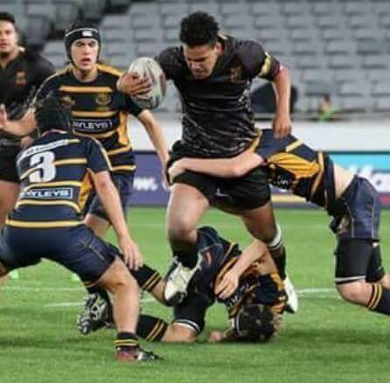

Slide 10
Interventions
Based on feed back from:
Strengths and Difficulties Questioner forms.
Feedback from parent, teachers and students.
We feedback to the champion what the need is and they make the necessary arrangements.
Our interventions include homework centres, referrals to counsellors, RTLB referrals, sport team referrals, classroom observations and motivational meetings.

Slide 11
Acknowledgements
Jude Harris – RTLB Cluster Manager (Our Chief)
Roger Phillipson: Regional (Northern) Behaviour Service Manager - PB4L | Special Education, Ministry of Education
Penny Cox: Clinical Supervisor, Educational Psychologist – Ministry of Education
Jennice Murray – Principal, Don Buck Primary School

